Slide 1
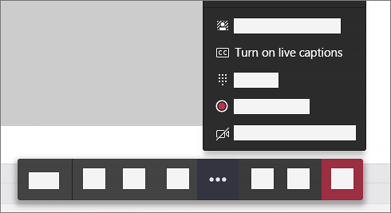
Foreword for MS Teams 📌
For zooming in, use CTRL + MOUSE WHEEL
Move around with mouse dragging
Live closed captions in upper right in MS Teams
Works for English only at the moment 😑
Source: Microsoft documentation
Notes:
Source: https://support.microsoft.com/en-us/office/use-live-captions-in-a-teams-meeting-4be2d304-f675-4b57-8347-cbd000a21260?ui=en-US&rs=en-US&ad=US

Slide 2

Automated provisioning of SQL Server VMs on Azure
1st Dativerse Conference
August 13 2021
Kay Sauter

Slide 3
Foreword for MS Teams 📌
For zooming in, use CTRL + MOUSE WHEEL
Move around with mouse dragging
Live closed captions in upper right in MS Teams
Works for English only at the moment 😑
Source: Microsoft documentation
Notes:
Source: https://support.microsoft.com/en-us/office/use-live-captions-in-a-teams-meeting-4be2d304-f675-4b57-8347-cbd000a21260?ui=en-US&rs=en-US&ad=US

Slide 4

Kay Sauter (He/Him)
Senior BI Consultant @ OneDigit AG
SQL Server, PBIRS, SSAS and Azure
Working with data since 2008
Born deaf
Has bionic ears (Cochlear Implants)
Avid traveller with wife
Data TGIF founder & organizer
From Zurich, Switzerland
Notes:
Work for OneDigit https://www.onedigit.ch/
Work with data for more than 12 years
Mostly SQL Server, but also SSAS and Azure
I am hearing impaired, so please use text chat for questions
More info about CI on my Github page github.com/kaysauter/CochlearImplant

Slide 5



Questions? 💬
Blog kayondata.com | onedigit.ch
@kaysauter
kay@kayondata.com | kay.sauter@onedigit.ch
linkedin.com/in/kaysauter
Data TGIF: meetup.com/data-tgif
github.com/kaysauter/Sessions
👉 Code will be on github
Notes:
If you have any questions after the presentation, feel free to contact me through one of those channels

Slide 6



Goals 🎯
Create a VM on Azure with PowerShell
Secure connection to VM via TSL/SSL
Install SW on VM via PowerShell
Insights into Pricing 💶
Notes:
Other options like Chef, Ansible etc. are not from Microsoft
This solution focuses on rather simple deployments for few VMs

Slide 7
Agenda
Why 🤔
Architecture 🏛
Security 🔐
Code and tools 💻
Demo ⚗
Pricing 💶

Slide 8

Why automate VM deployments?
Always have same setup easily → Reusability
DEV ENV that can be deleted if needed
Testing
Showcasing (eg. via Azure Labs)
A way to save costs
Notes:
Use case OneDigit -> Everyone can do it

Slide 9
Why PowerShell and not…?
PowerShell is native tool provided by Microsoft
PowerShell: many DBAs already use it
Other possiblity: ARM (Azure Resource Manager), example follows
Very new: Bicep, but still «growing up»
Ideal for smaller scaled use cases
Notes:
Use case OneDigit -> Everyone can do it

Slide 10
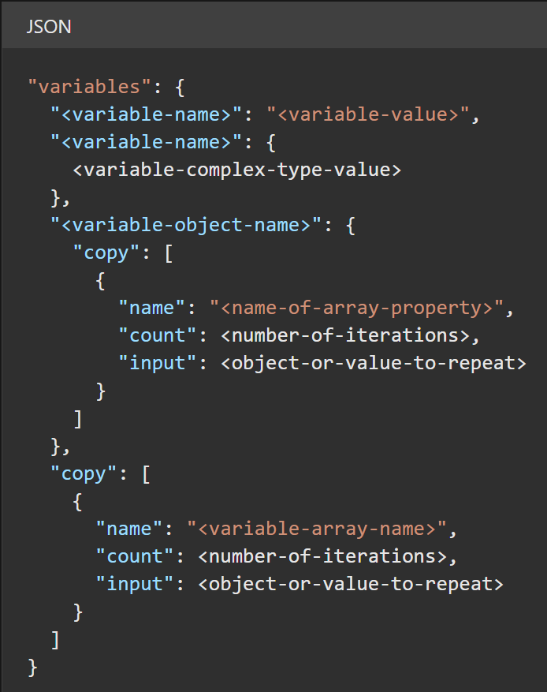
Why PowerShell and not…?
Example of ARM 👉
Gets convoluted quickly
Code is an introductory example by Microsoft https://docs.microsoft.com/en-us/azure/azure-resource-manager/templates/syntax

Slide 11
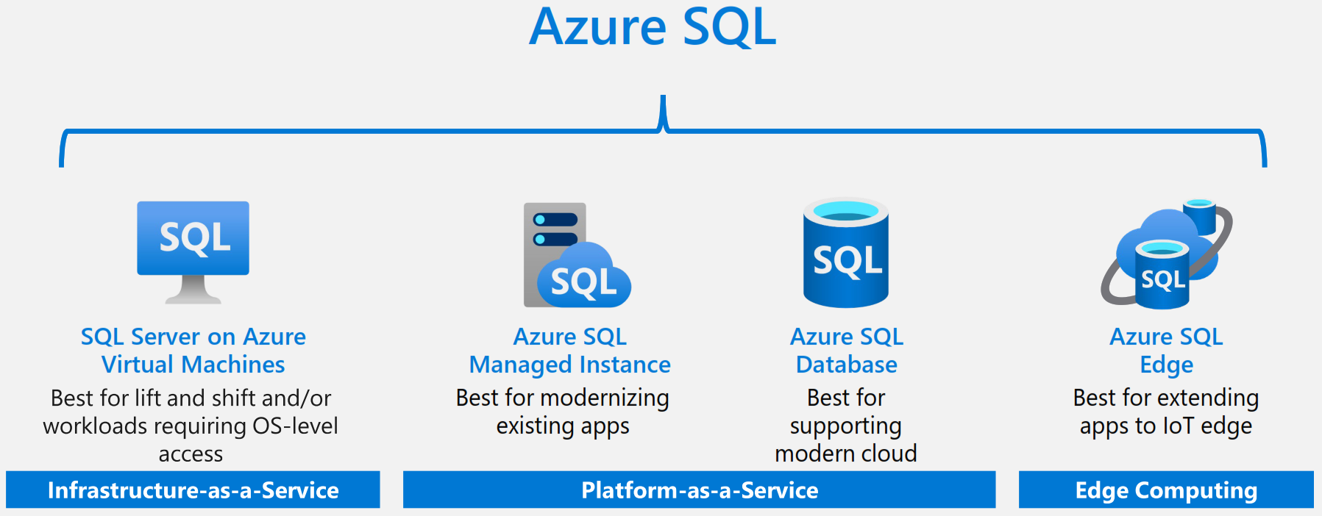
Overview on Azure Platform
Notes:
Source: https://azure.microsoft.com/en-us/resources/get-to-know-azure-sql/

Slide 12
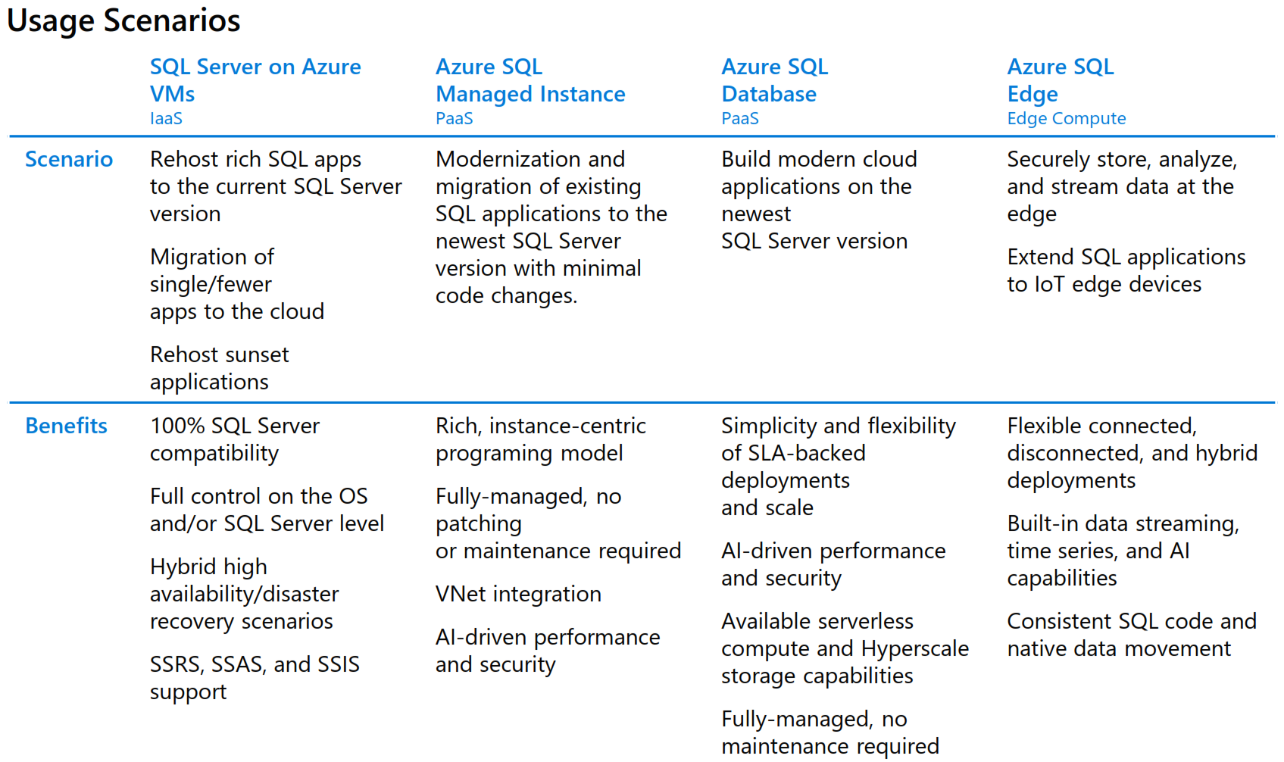
Overview on Azure Platform
Notes:
Because you have full control on VMs, compliance with regulatory reasons can be easier
Still ideal for complex data warehouses
For swiss banking and finance industry, often preferred because for full datawarehouse solutions, still most capabilities
Source: https://azure.microsoft.com/en-us/resources/get-to-know-azure-sql/

Slide 13
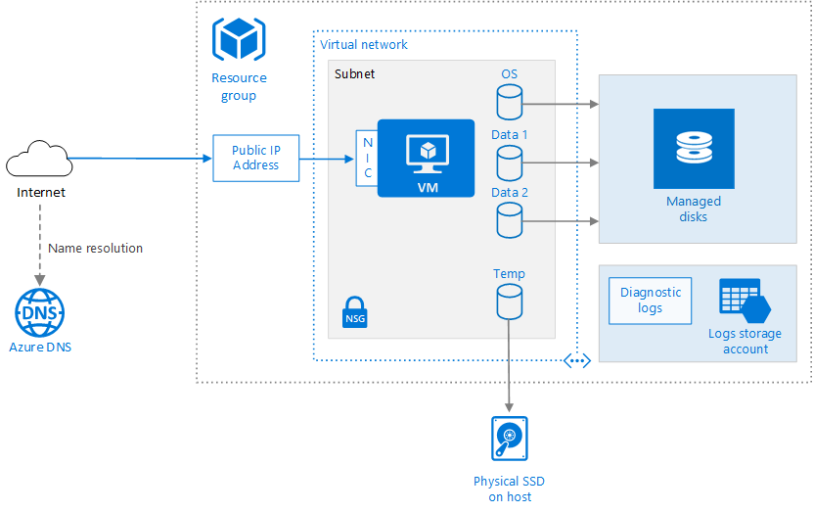
Base Architecture for VM
Notes:
Base Architecture for VM
Important: Resource Group which is basically a grouping mechanism to apply everything in it, eg. to move into a different region
Source: https://docs.microsoft.com/en-us/azure/architecture/reference-architectures/n-tier/windows-vm

Slide 14

How to bring your backups into VM?
Backup files upload via Drag & Drop
https://azure.microsoft.com/en-us/features/storage-explorer/
Azure File Storage will be mapped on VM as Z:\ with PowerShell
Notes:
We are going to restore databases from Azure File Store
Files can be uploaded by Azure Data Store Explorer via Drag & Drop
Link: https://azure.microsoft.com/en-us/features/storage-explorer/

Slide 15
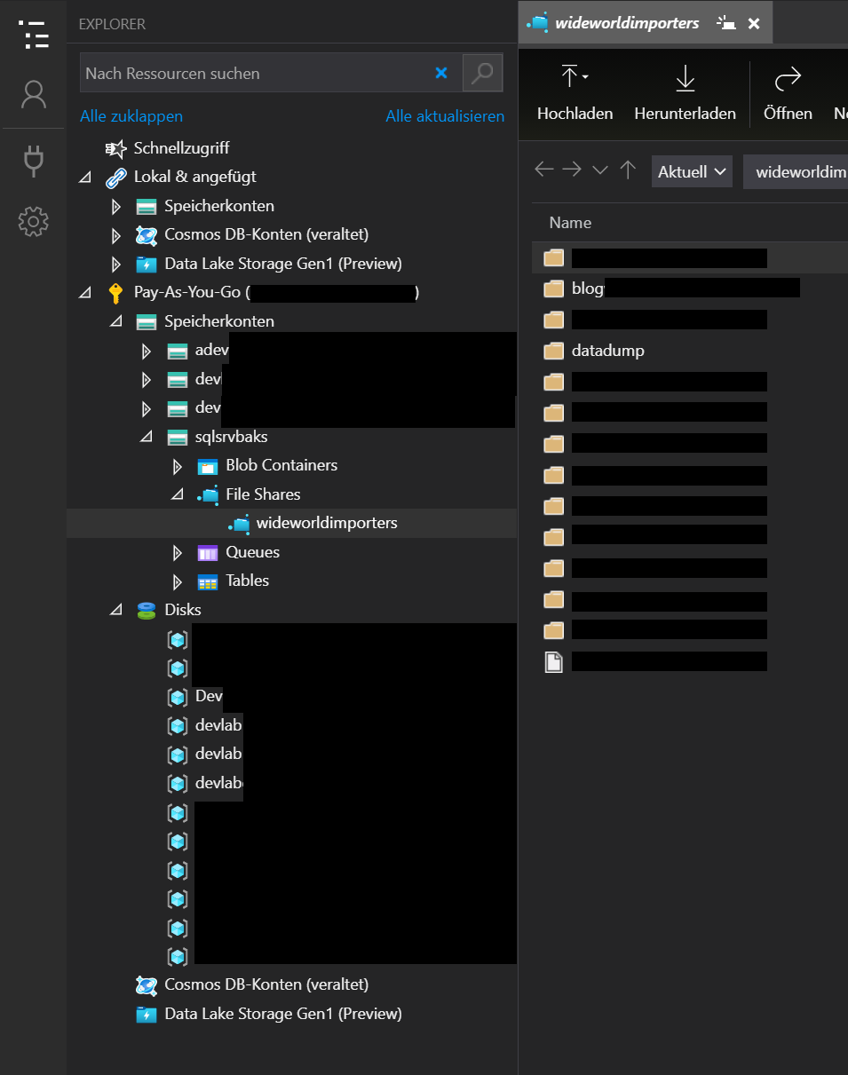

Azure Storage Explorer
Drag & Drop
AdventureWorks.bak
Notes:
https://azure.microsoft.com/en-us/features/storage-explorer/

Slide 16
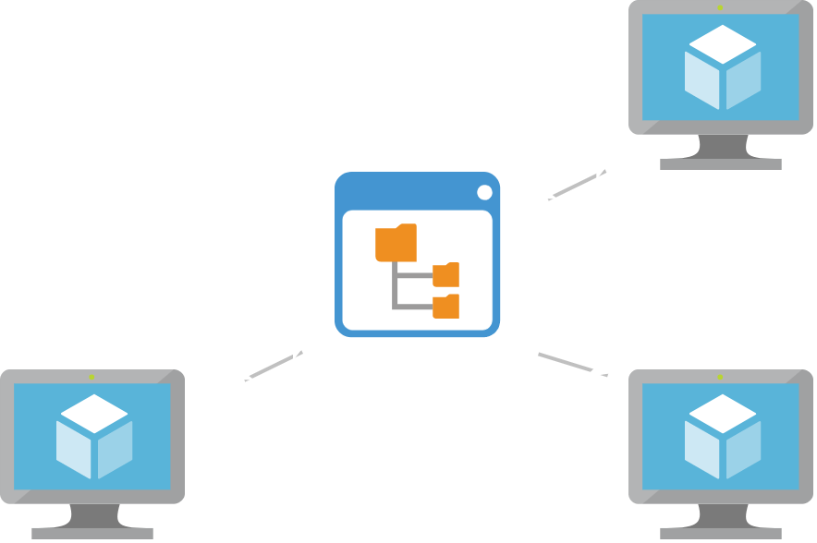
Azure File Storage
File storage with backups of databases
File storage is way cheaper than VM storage
For multiple VMs, you can have one central storage
Is mappable in VM as a network drive.
Notes:
Azure File Store as mapped drives

Slide 17

RDP over Internet is risky!
RDP over internet should always encrypted
microsoft.com/security/blog/2020/04/16/security-guidance-remote-desktop-adoption/
Notes:
Prone to port scans and potential DDOS risks
https://www.microsoft.com/security/blog/2020/04/16/security-guidance-remote-desktop-adoption/

Slide 18
Azure Bastion for security 🔐
Azure Bastion is easy to set up
Managed by Microsoft – Security as a Service
Works with a browser, RDP gets tunneled with SSL
Public IP address is not exposed
Alternative: End-to-End VPN from Azure to Company is possible, but not easy
Notes:
The Bastion host is deployed in the virtual network that contains the AzureBastionSubnet subnet that has a minimum /27 prefix.
The user connects to the Azure portal using any HTML5 browser.
The user selects the virtual machine to connect to.
With a single click, the RDP/SSH session opens in the browser.
No public IP is required on the Azure VM.

Slide 19
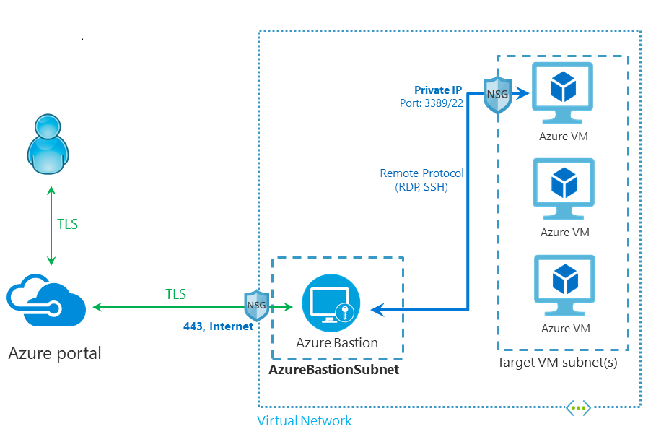
Architecture Azure Bastion
Diagram by Microsoft,
Azure Bastion Docs
Notes:
Architecture for Azure Bastion.
NSG = Network Security Group
Source: https://docs.microsoft.com/en-us/azure/bastion/bastion-overview

Slide 20
💬 Questions?
Next: Code for demo prep
github.com/kaysauter
Notes:
I’m going to show you the main parts of the code, but I won’t go through everything because that would be about 100 lines of code
I’m going to show you gotchas and how you can adapt it for yourself easily
Again: full code will be on github.com/kaysauter

Slide 21
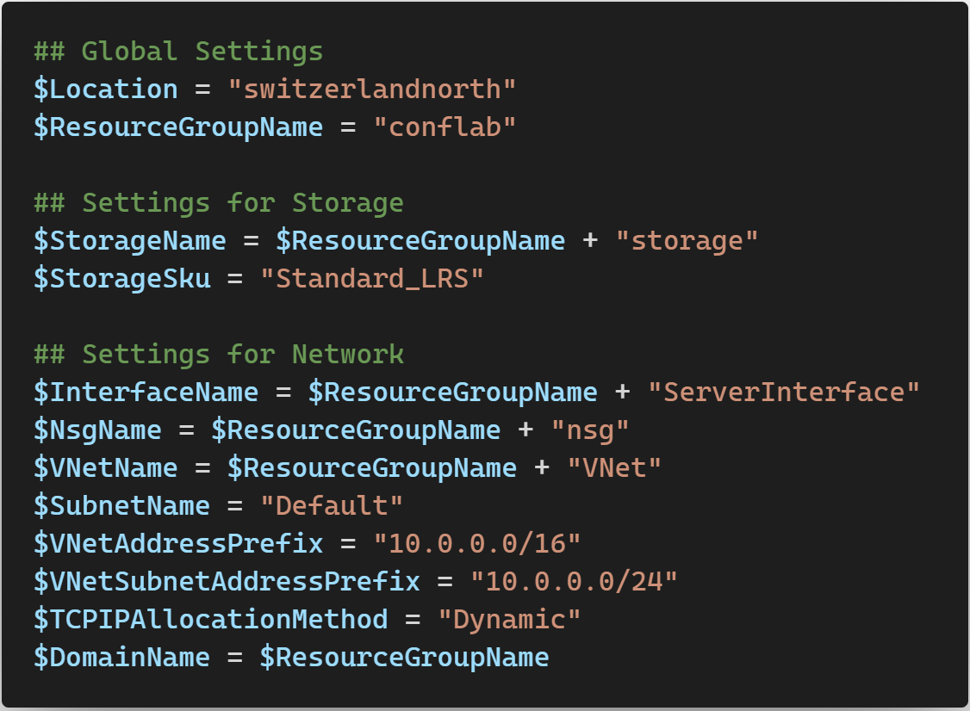

Slide 24
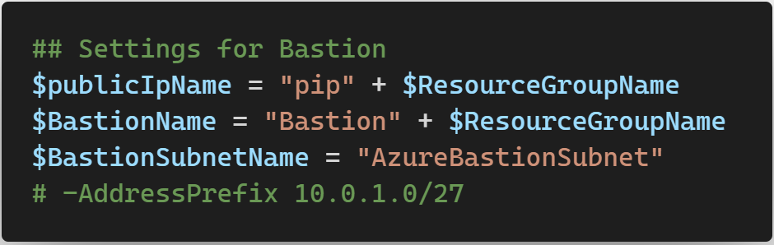

Slide 25
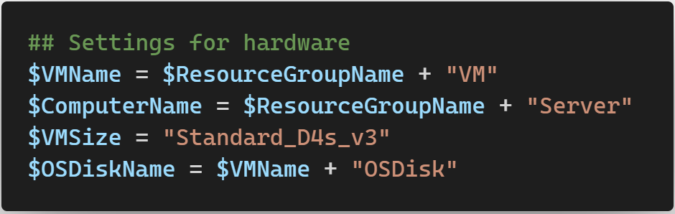

Slide 26
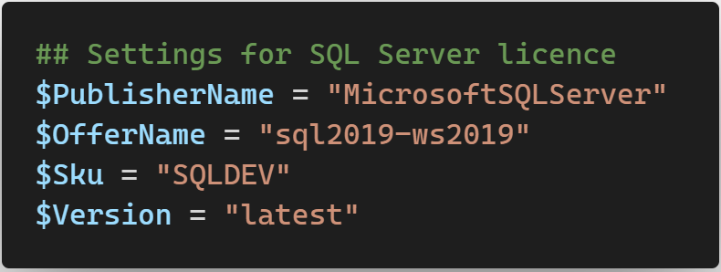
Notes:
This is the VM out from the catalog provided by Microsoft
SQLDEV means it is the SQL Server DEV Edition which is licensed for non production purposes
Version → latest Version refers to the latest version of it

Slide 27
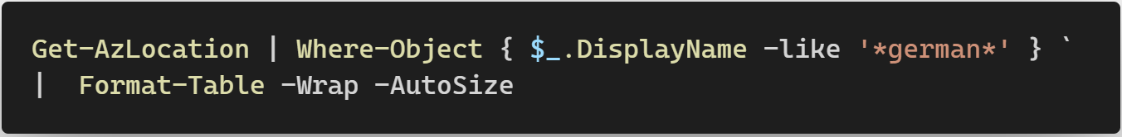
Notes:
Going to show you how you can adapt the code for yourself

Slide 28
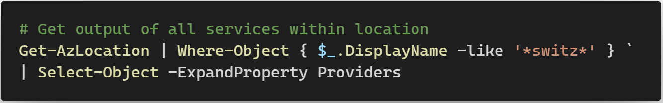
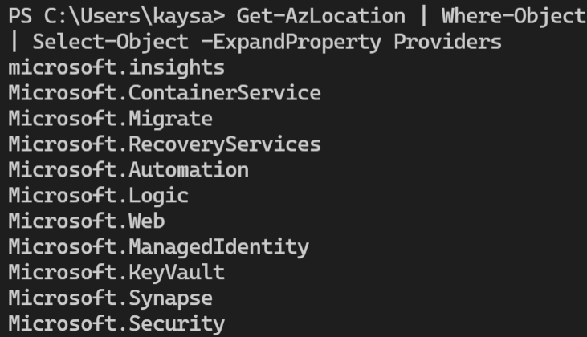

Slide 29
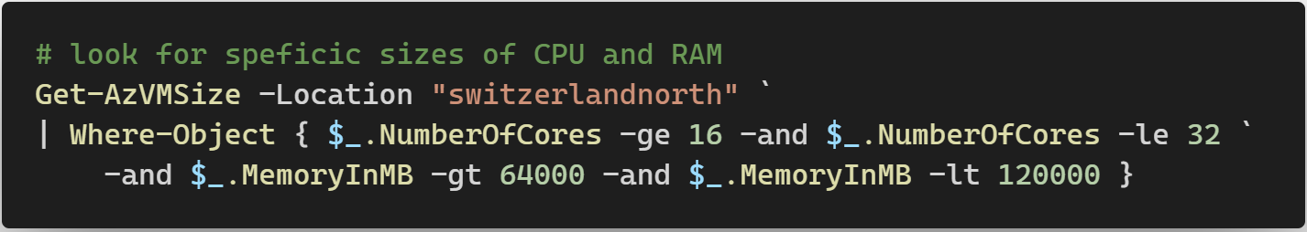
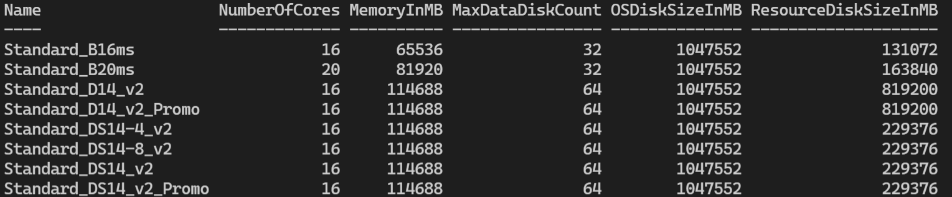

Slide 30
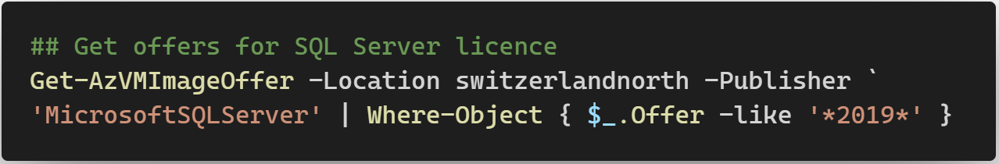
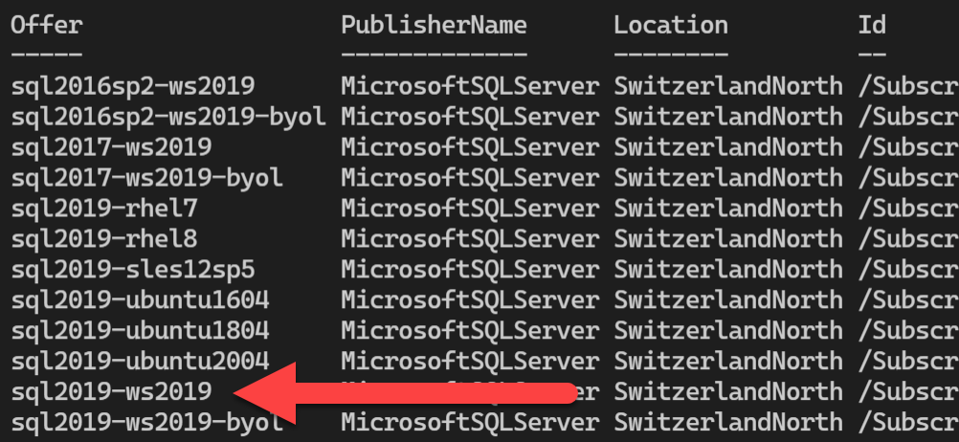

Slide 31
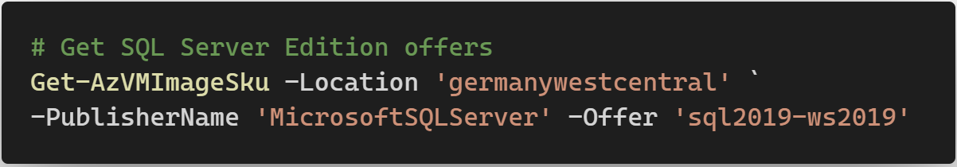
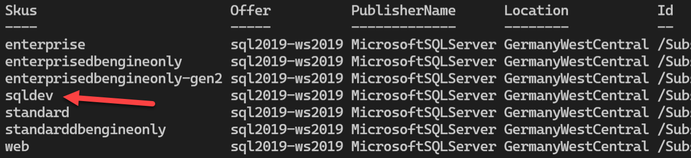

Slide 32
💬 Questions?
Next: Code for software on VM
github.com/kaysauter
Notes:
I’m going to show you the main parts of the code, but I won’t go through everything because that would be about 100 lines of code
I’m going to show you gotchas and how you can adapt it for yourself easily
Again: full code will be on github.com/kaysauter

Slide 33
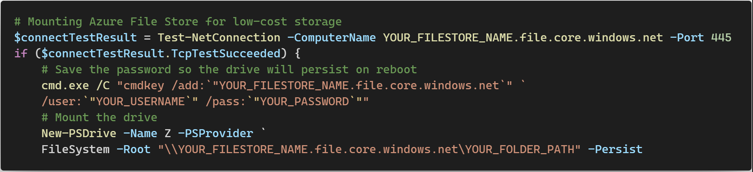
Mapping Network-drive 💾

Slide 34

Chocolatey
Bases on PowerShell
Opensource & free
Can download and install software automatically
Huge library of software
Is secure: checksums ℹ docs.chocolatey.org/en-us/information/security
Notes:
For more information see https://docs.chocolatey.org/en-us/information/security

Slide 35
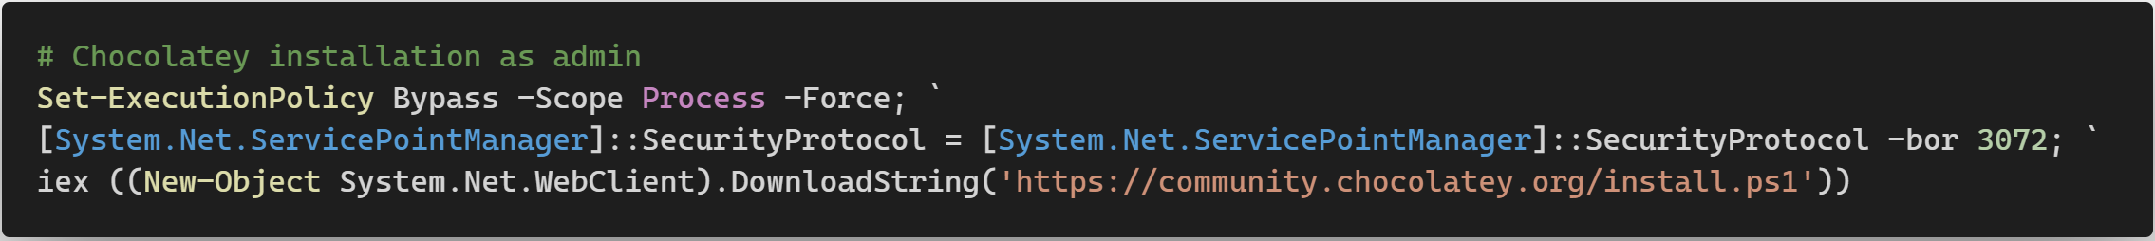
Install Chocolatey
ℹ more info & other install possibilities:
chocolatey.org/install

Slide 36
Code Samples
Use Chocolatey as admin in Terminal: choco install <Name1> <Name2>… -y

Slide 37
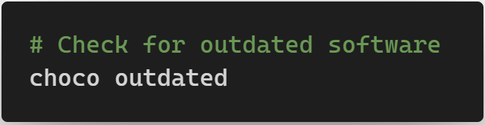
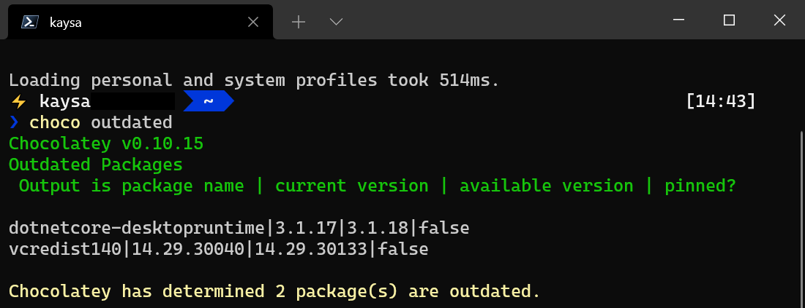
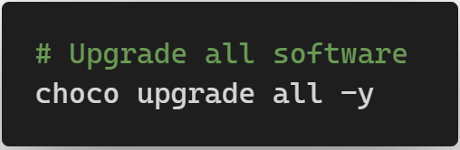
Upgrading is easy

Slide 38
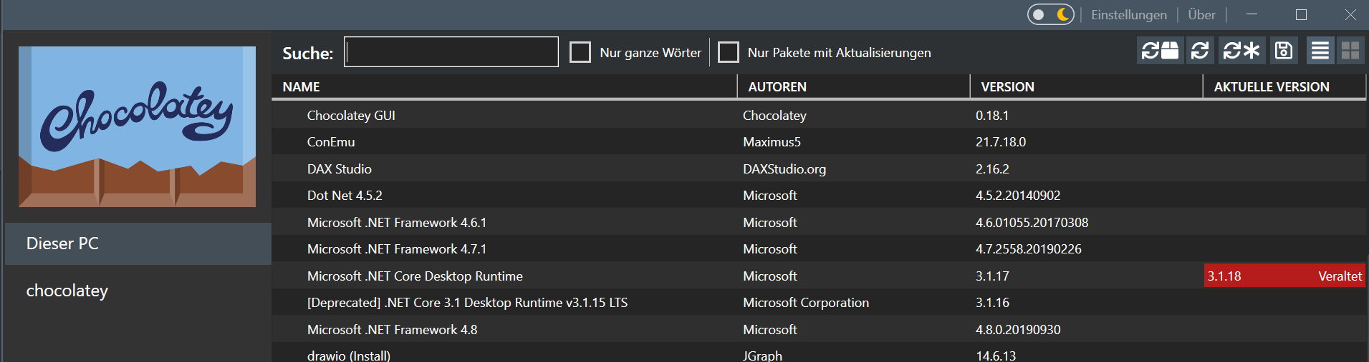
Has also GUI

Slide 39
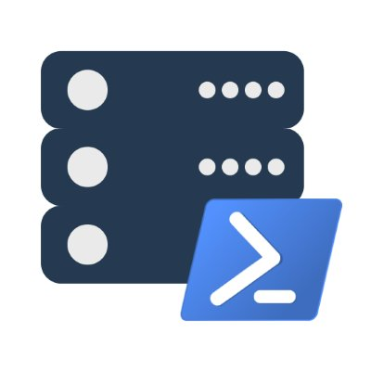
dbatools
«SSMS via PowerShell»
Open Source and free, code on GitHub
Created by Chrissy LeMaire, maintained by her with Jess Pomfret & Shawn Melton
Very powerful and easy to use

Slide 40
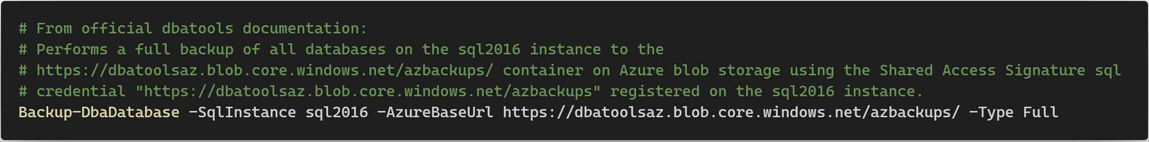
dbatools
Code sample:

Slide 41
Automation On / Off VM
It is possible to tell Azure to power off a VM at a given time
You can save money that way
It is also possible to start a VM on given days/time

Slide 42
Backup & restore
Backup of VMs is possible
Backup for securing data
Restore is takes a few mins
Can be done in PowerShell

Slide 43
💬 Questions?
Next: Demo ⚗

Slide 44
💬 Questions?
Next: Pricing 💵

Slide 45
Pricing 💶
Rather complex
Pricing types:
Pay as you go
Reserved Virtual Machine Instances
Spot pricing
BYOL: Bring Your Own License
Depends on hardware you pick
Software licenses

Slide 46
Pricing 💶
Pay-as-you-go
The standard
Pay only what and when you use
Very easy, can be cheapest if used only momentarily
Most expensive option if always used
A resource deleted = not paying anymore

Slide 47
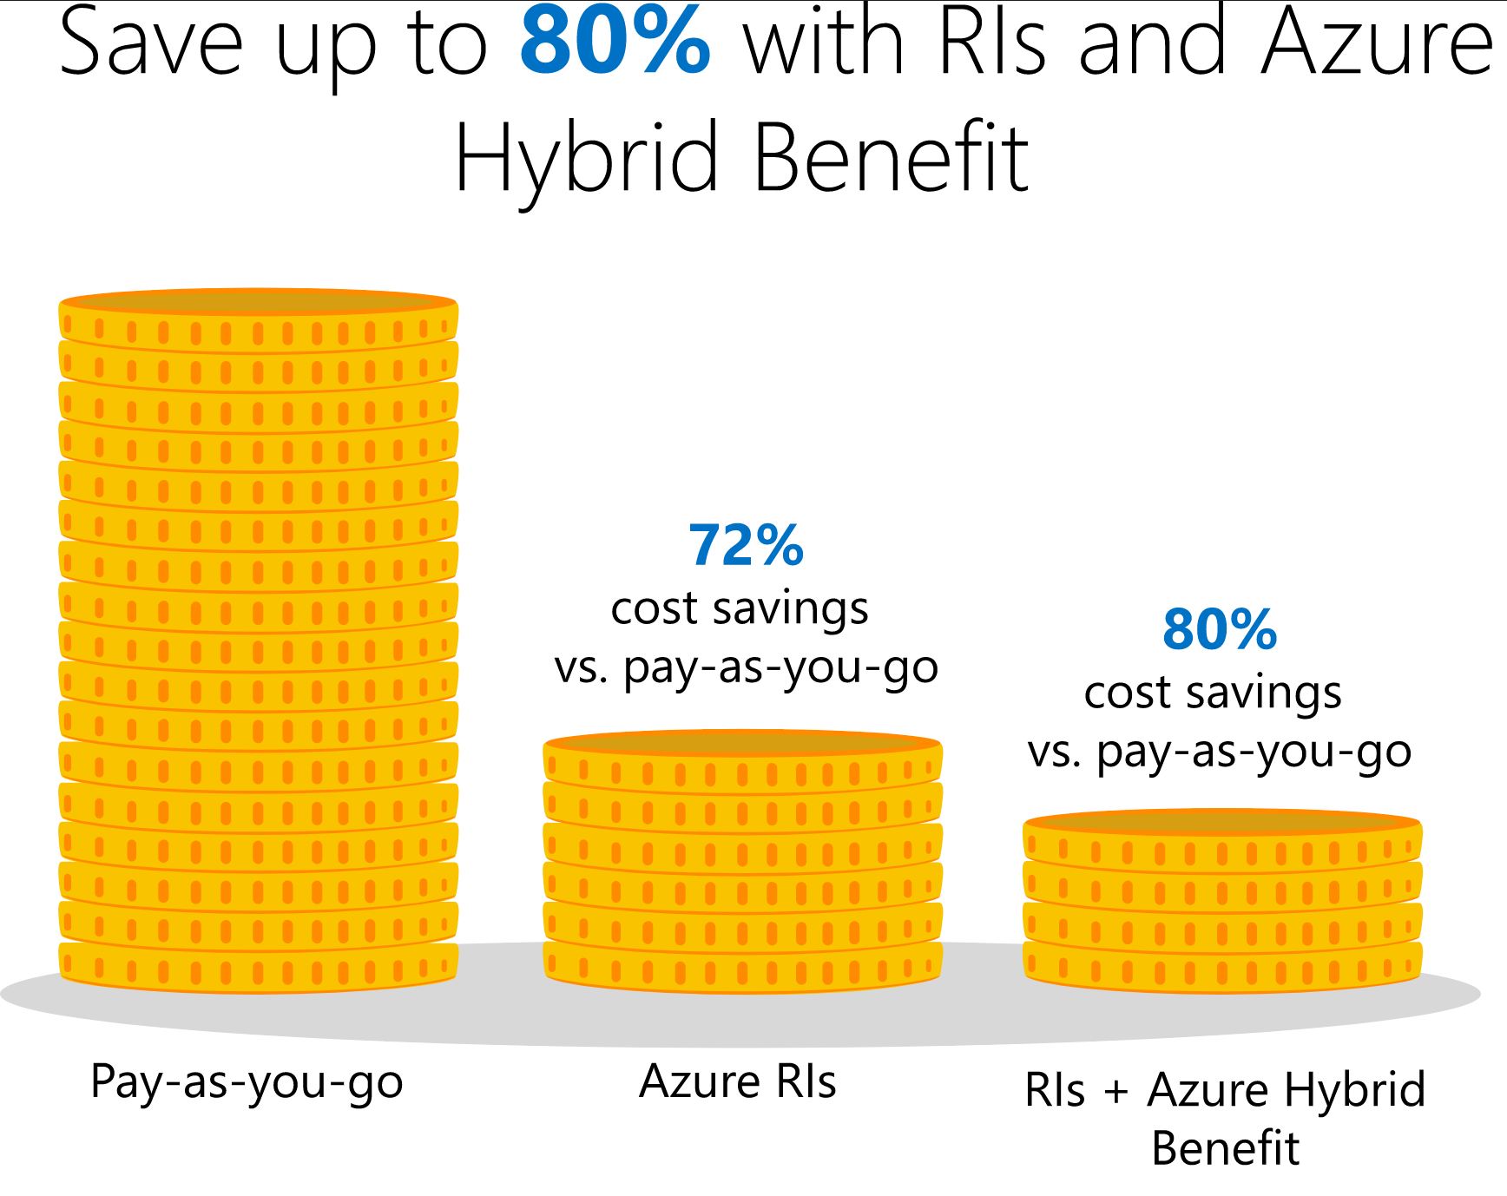
Pricing 💶
Reserved Virtual Machine Instances
Pay for longer term «hosting»
You reserve a spaced resource for you
Up to 72% cheaper
With Azure Hybrid up to 80%
Source: azure.microsoft.com/en-us/pricing/reserved-vm-instances/

Slide 48
Pricing 💶
Spot pricing
For failure-tolerant usecases
You can live with sudden shutdowns
Around 90% less cost
Ideal for students, «playing around» as a dev
Can be used for PRD but very limited usecases
Source: azure.microsoft.com/en-us/services/virtual-machines/spot

Slide 49
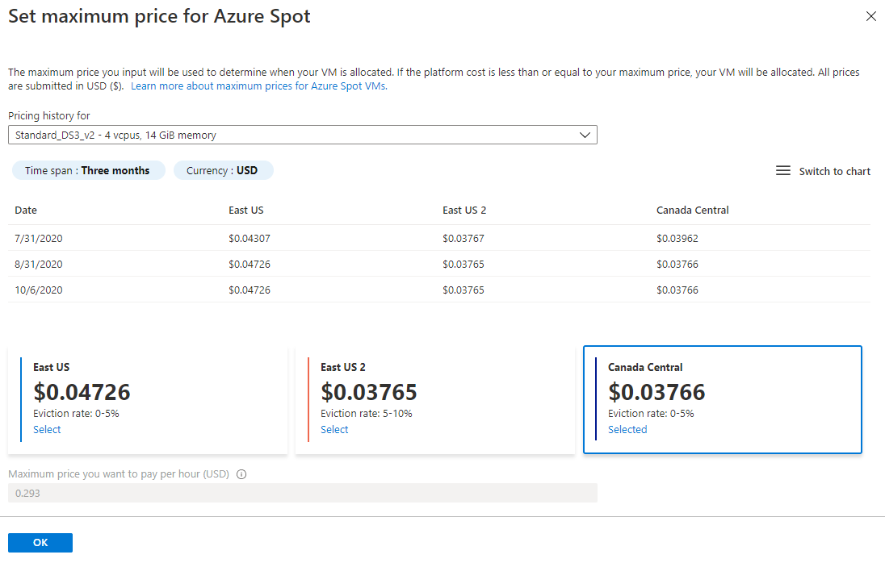
Pricing 💶
Spot pricing

Slide 50
Pricing 💶
BYOL
Bring Your Own License
May be useful if you’ve got a license you bought but don’t use

Slide 51
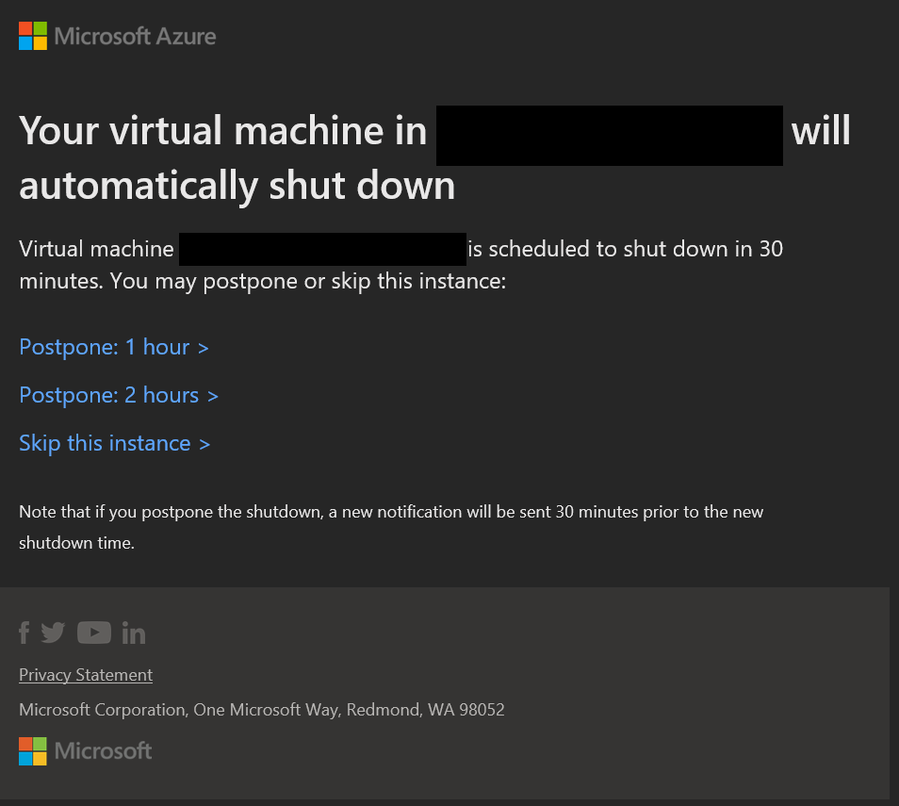
Pricing 💶
If a VM is shut down, it costs less because no CPU / RAM used
You can automate Shut-Downs, eg. 19:00 with Email-Warnings with possiblity to postpone

Slide 52
Pricing 💶
You can scale up / scale down a VM which also impacts pricing
You can set up a budget to limit expenses including warnings

Slide 53
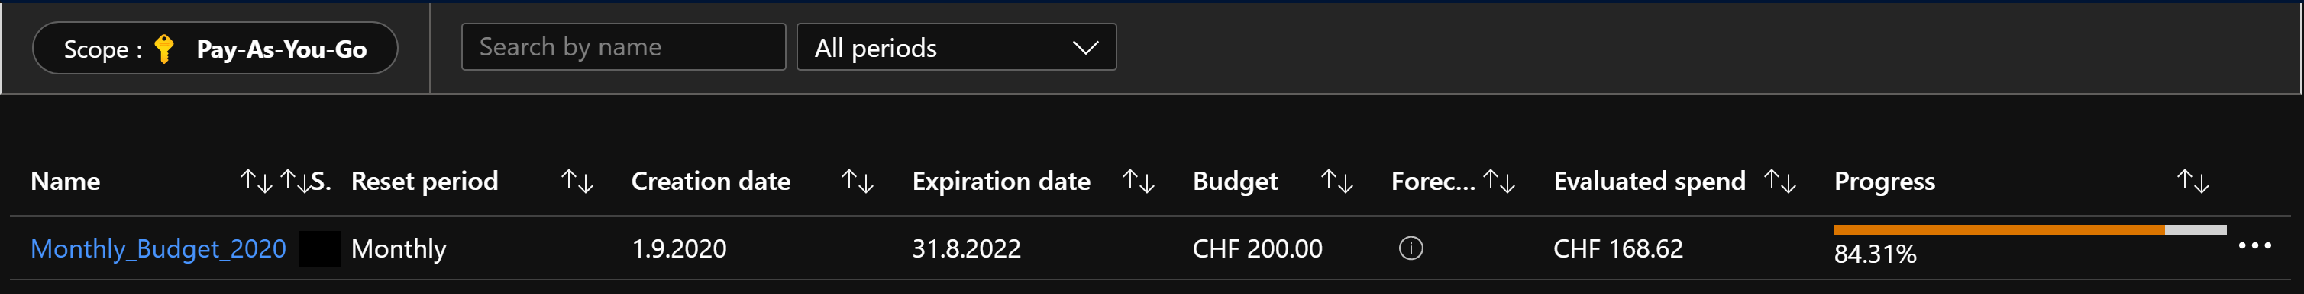
Pricing 💶
Cost management

Slide 54
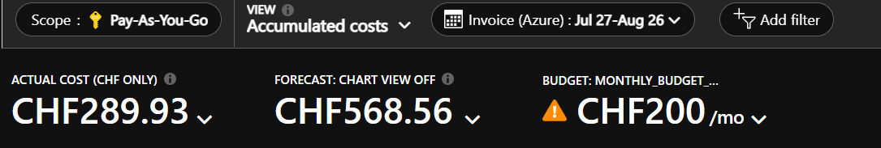
Pricing 💶
Cost management
Forecasts by Azure – works pretty well and assumes a worst-case-scenario

Slide 55
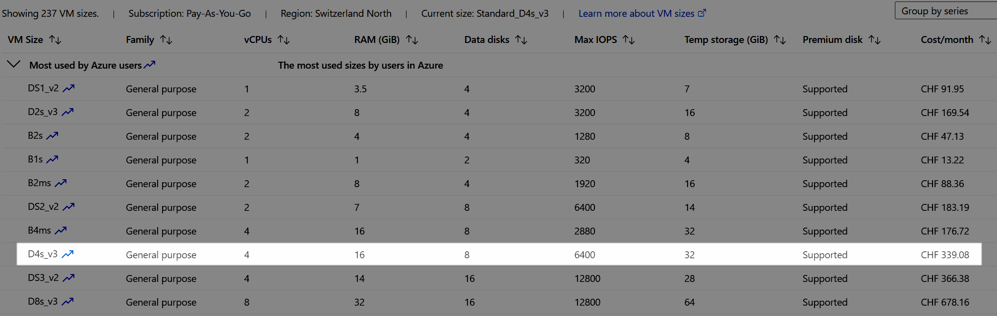
Pricing Example 💵
File store size: 5 TB
Notes:
Microsoft has a catalog of different VMs you can choose from
They differ in their hardware builds, for example better or weaker CPU / RAM / Harddisk options
The more Ram / CPU you need, the expensive it gets

Slide 56
Real Example Month April for a Test ENV
Cost breakdown in EUR
Cost breakdown in %
Notes:
Use case @ OneDigit AG
Cost total 138 Eur

Slide 57
Recap
Almost fully automated provisoning only with PowerShell of VMs with SQL Server and restored databases is possible
Solution uses an approach from desktop via PowerShell
Chocolatey and dbatools are great helpers

Slide 58
Questions? 💬
Blog kayondata.com | onedigit.ch
@kaysauter
kay@kayondata.com | kay.sauter@onedigit.ch
linkedin.com/in/kaysauter
Data TGIF: meetup.com/en-US/data-tgif
github.com/kaysauter/Sessions
Code will be on github
Notes:
If you have any questions after the presentation, feel free to contact me through one of those channels

